Slide 1







RECYCLING REVOLUTION APP
SaafPakistan
LETS PAINT PAKISTAN GREEN!
Ali Sher
Nouman Ali
Mian Faizan Munawer

Slide 2
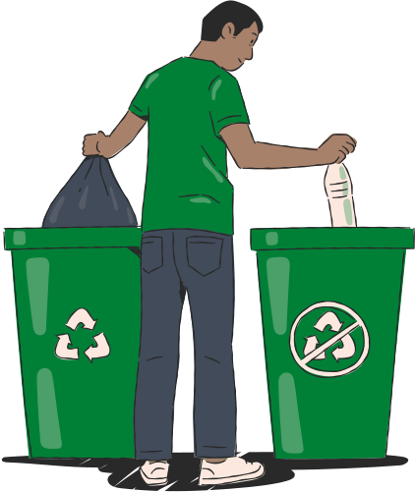
Problem
Pakistan's unstructured recycling system leads to disorganized waste disposal, causing environmental pollution and recyclable accumulation in landfills.

Slide 3
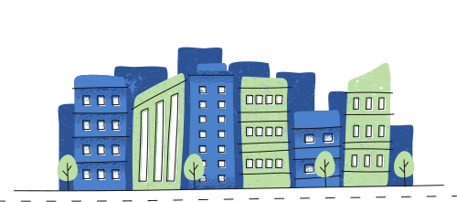
Statistics
City | Recyclable Waste Generated Daily/ Tons
Karachi | 16,500
Lahore | 7,690
Faisalabad | 5,017
Rawalpindi | 4,500
Hyderabad | 3,973
Pakistan waste generation grows 2.4% annually
Lahore Generates 7690 tons of waste on a daily basis
Only 27% of generated waste is being is recycled in Lahore
As of 2020, 190 acres of landfill are utilized, with a proposal for an additional 150 acres due to high waste generation
[1]
[1]
[2]
Solid Waste Generation In Major Cities
[1]
[3]
Waste Management in Pakistan (2022)by the U.S. Trade and Development Agency
Azam, M., et al. (2019). "Status, characterization, and potential utilization of municipal solid waste as a renewable energy source: Lahore case study in Pakistan."
COMPENDIUM ON ENVIRONMENT STATISTICS OF PAKISTAN 2020

Slide 4
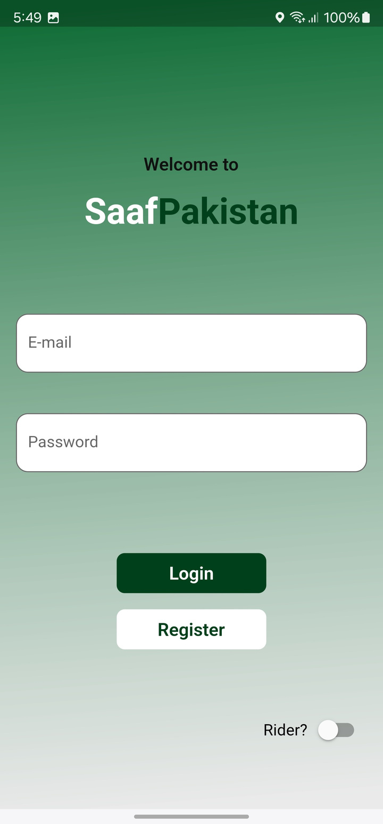
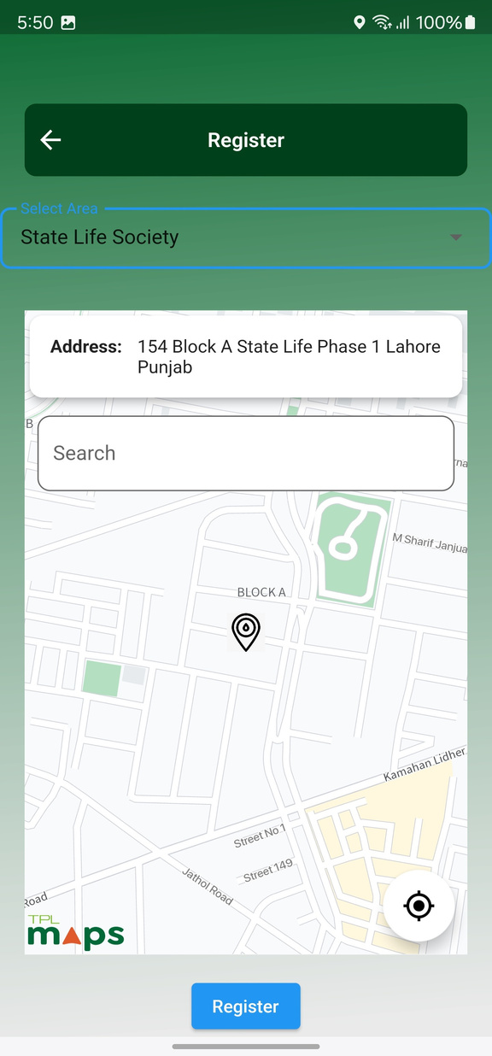
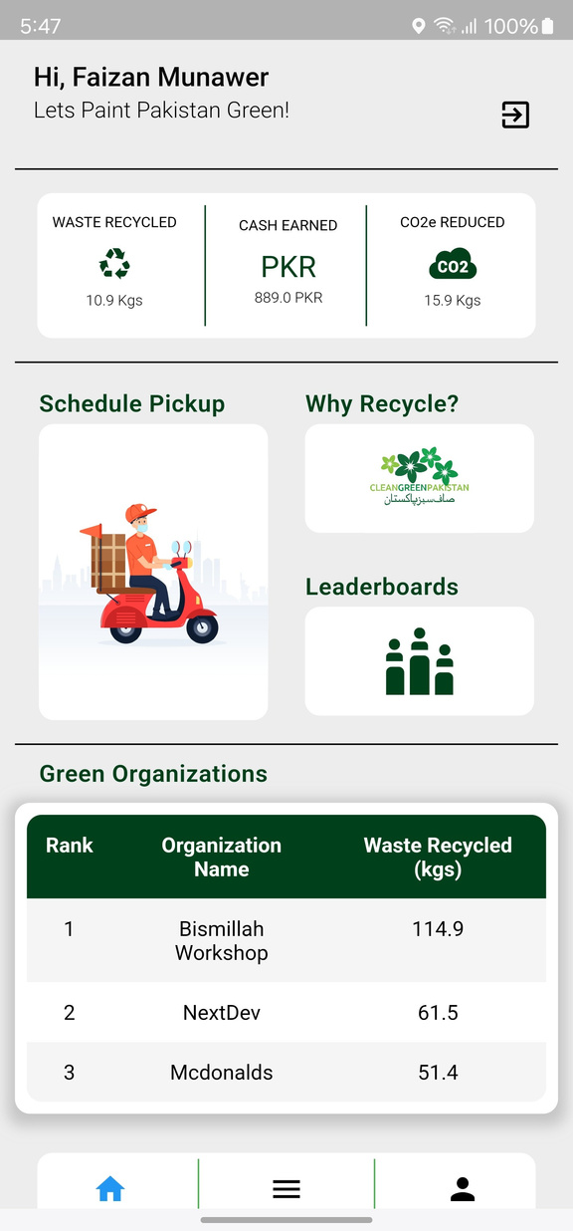
Solution
"Introducing SaafPakistan, Your App for a Cleaner, Greener Tomorrow!"

Slide 5
Features
Progress
Get updated of your real-time progress
Educational Content
Schedule Pickup for Recycling
Gamification
A dynamic leaderboard system for individuals and businesses, fostering a sense of competition.
Compete against friends
For Green Marketing

Slide 6
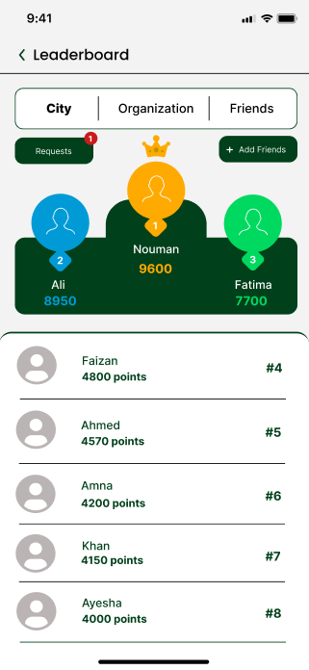
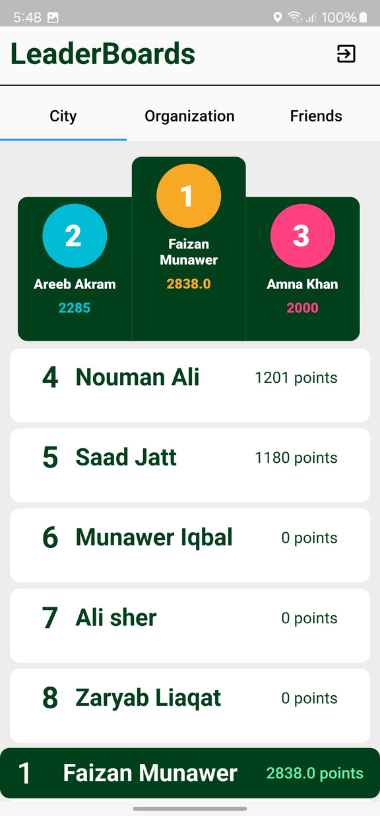
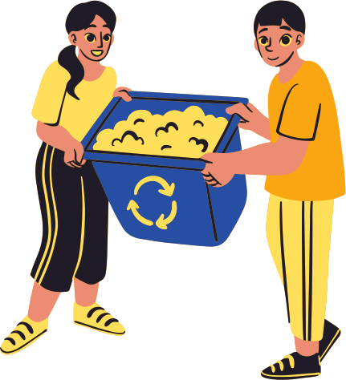
Dynamic Leaderboards
Recycle Together OR Compete against Friends

Slide 7
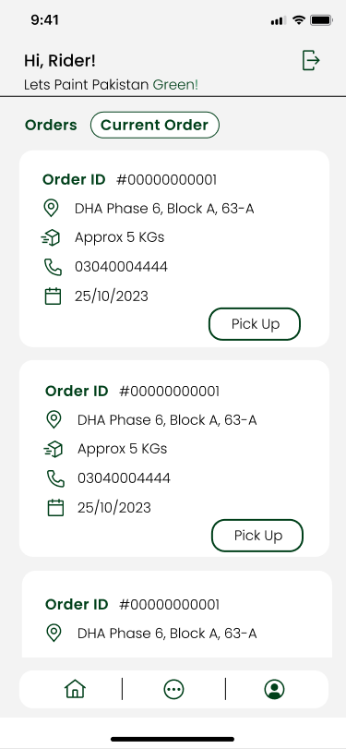
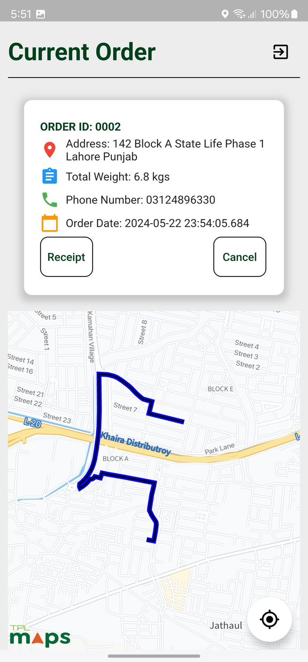
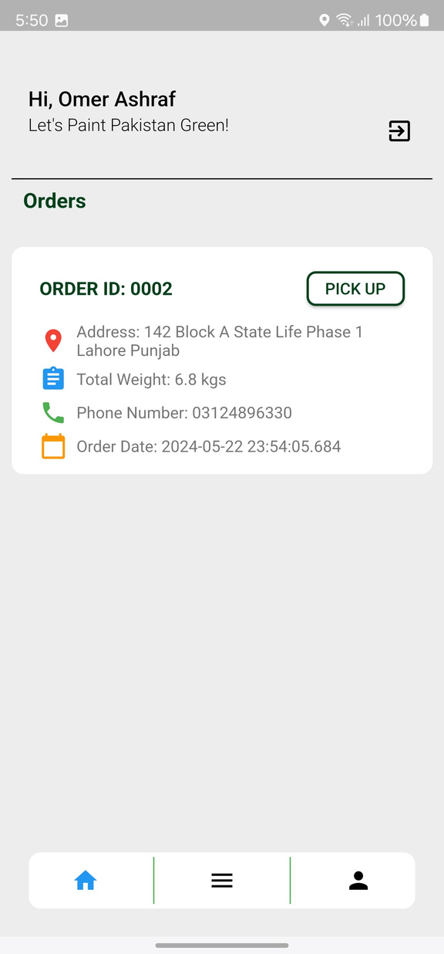
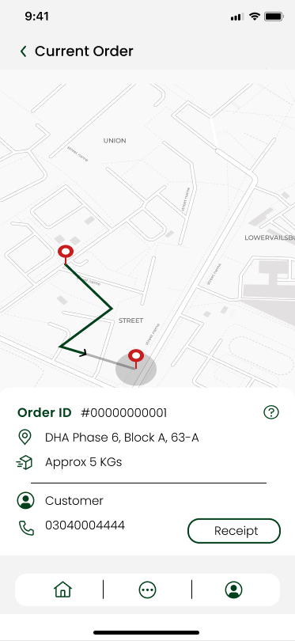
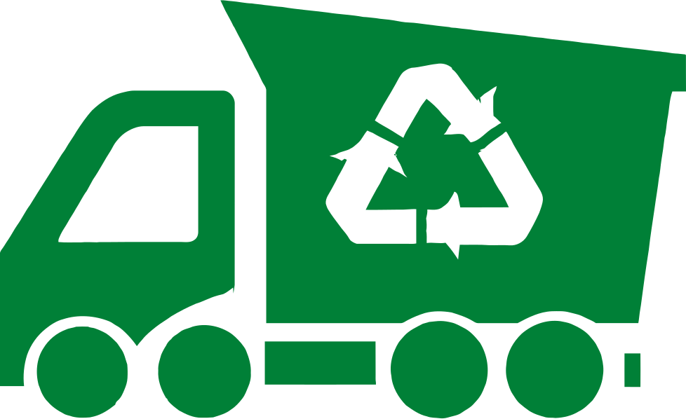
Dedicated App For Rider
Rider Dashboard
Integrated Maps

Slide 8
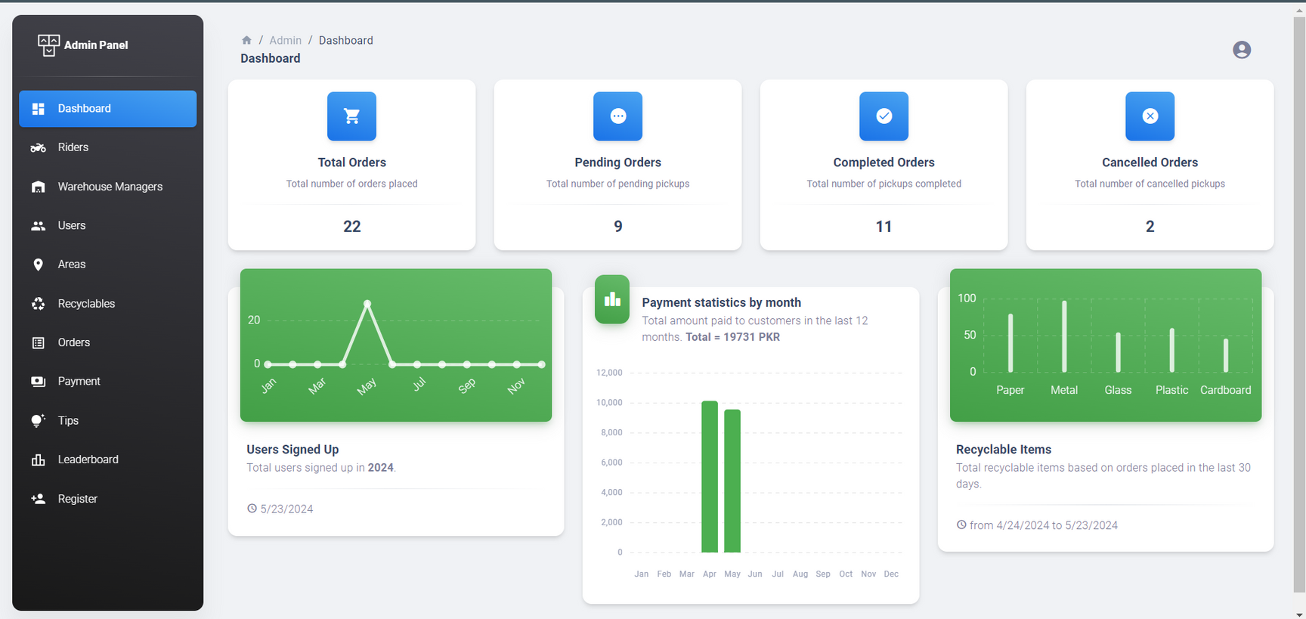
Admin Panel
Centralized hub for managing and overseeing system functionalities, user accounts, and data.

Slide 9

High-Level Architecture
Admin
[Person]
Warehouse Manager
[Person]
Customer
[Person]
Rider
[Person]
SaafPakistan Admin, Managing riders and warehouse manager
saafPakistan Warehouse manager, Confirming riders delivery to warehouse
A customer of the Saafpakistan, Recycling through the app
A rider working for saafPakistan
register riders, register warehouse manager, and upload Material's rates payment proof using
view pending
and completed pickups,
confirm rider deliveries
using
Schedule Recycling pickups,
View Personal recylcing stats,
Compete with friends and others with leaderboards, view payments recieved
and their status using
view and complete
assigned pickups and
generate receipts using
Web Application
[Container: React]
Mobile Application
[Container: Flutter]
Provides Admin to manage
mobile app users and the system
and Warehouse manager to manage rider pickups via web app
Provides customer an app
for their recycling needs.
Provides rider the ability to
complete pickups via mobile
device
Database
[Container: Firebase Firestore]
Stores user information,
rider information,
Admin Information,
Recycling Materials Rates,
Leaderboard Rankings,
Recycling schedules
hashed authentication credentials, etc.
Read from and writes to
Makes API calls to
API Application
[Container: Node.js]
Provide functionalities via
JSON/HTTPS API
Read from and writes to
Software System

Slide 10
Work Done FYP-1
Documented System Requirements
Documented System Design
Developed Mobile App prototype in Figma
Implemented Mobile App Customer Signup/Login
Implemented Mobile App Rider Signup/Login
Implemented Web App Signup/Login

Slide 11
Challenges
Faced difficulty while integrating the maps functionality into the mobile application
Elicitation of Domain knowledge
Solution
Collaborated with map API providers to resolve compatibility issues
Collaborate with local vendors and recycling organizations to gather domain knowledge for the app

Slide 12
Future Work
Integrate real-time tracking of recycling pickups.
Expand reward partnerships.
Incorporate machine learning algorithms to predict and optimize recycling patterns.

Slide 13
Thank You Very Much!
Now the System Demos

Slide 14
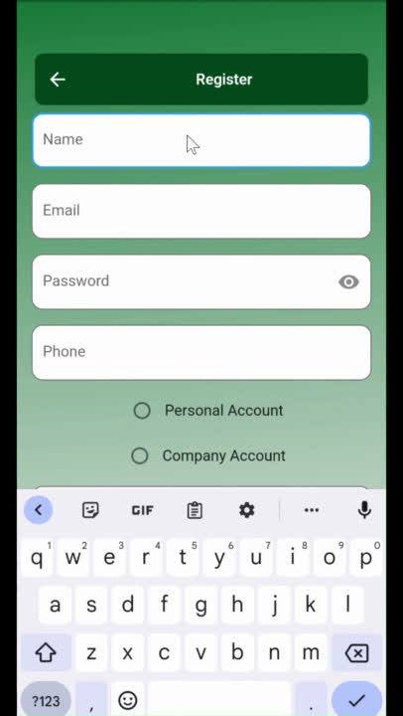
Mobile App Demo

Slide 15
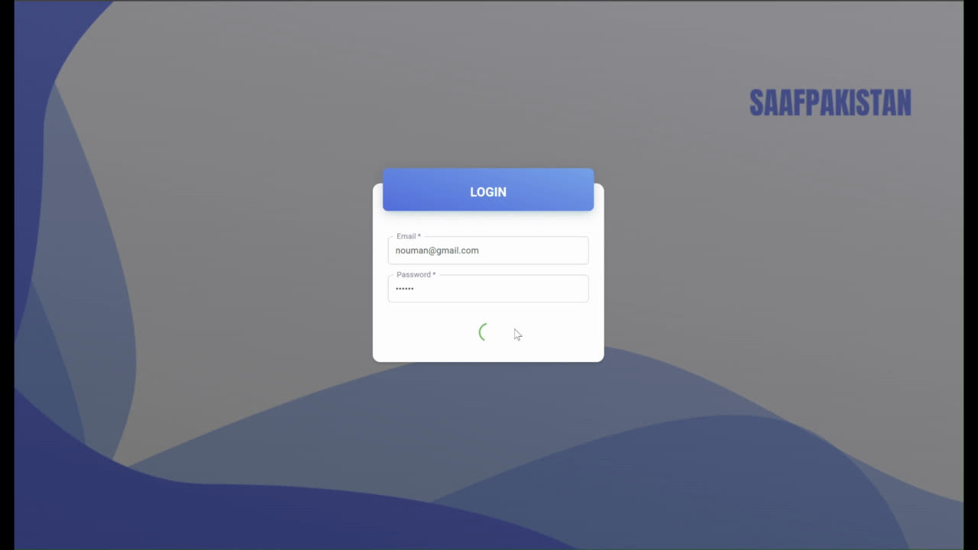
Web App Demo

